Slide 1
Cryptographic Hash Functions
One Way Functions
The Password Problem
Hash functions
Cryptographic Hash Functions

Slide 2
Functions and their Inverse
For every one-to-one function f(x), we can define its inverse f ⁻¹(x), such that
f ⁻¹( f(x) ) = x and f( f⁻¹(x) ) = x
For example,
f(x) = x*5 f⁻¹(x) = x/5
f(x) = x+100 f⁻¹(x) = x-100
f(x) = encode(x) f⁻¹(x) = decode(x)
f(x) = a^{x} mod n f⁻¹(x) = a^{-x} mod n
(a and n are constants)

Slide 3
What is a one-way function?
A function f: S → T, where S and T are any sets.
f: S → T is a one way function such that
for any x ∈ S, f(x) is easy to compute,
(2) given the information that f(x)=y, there is no feasible way of obtaining (computing) x for a reasonably large proportion of y belong to T.
S
f(x) f ⁻¹(y)
Is is
easy hard
T

Slide 4
Example - fractorization
f(x) = x², f ⁻¹(x) = √x , both x² and √x are easy to compute. So it is not a one way function
f(x,y)= x ∗ y, f ⁻¹(x) = factorise(x)
e.g. 11 ∗ 17 = 187, 187 = x ∗ y
Can you work out x and y for 779 = x ∗ y?
How about 76542 and 109875? Are they easy to be worked out?
Factoring a product of two large distinct primes is hard.

Slide 5
Computation – hard or easy?
Easy - if a computation takes polynomial time
Hard – otherwise (the computation takes exponential time)
polynomial/exponential time what does it mean?
let a variable x represents the size of input data, e.g.
the total steps of the computation may be
a+bx+cx² (a polynomial formula) ; or
the total steps of computation may be
a^{x} (an exponential formula)

Slide 6
The Password Problem
An application of one way functions
Computer needs to keep user’s password. How to store password? Encrypt it? How? Note that, what encryption to use is going to be a public knowledge. Where and how do we store key?
One of solutions is to use a one way function f. For a password P, we work out Q=f(P), then store value Q in computer. Intruders can’t work out P from Q because it is too hard to do.
No key is needed when use one way function.

Slide 7
Use hashing idea to achieve one way function
Hashing – “chops and mixes”
It maps a piece of data (normally non fixed length) to an integer (fixed length, or call it digest ). In database application, we map keys, like names, DOB, etc to integers which are the memory addresses where data stored (hash table).

Slide 8
Hashing in general application:
name → number
number = index
= address of memory location
e.g hash1(rongyang) =
length(rongyang) mod 103
e.g hash2(rong) = (ascii(r) + ascii(o) +ascii(n) +ascii(g)) mod 1017
e.g hash3(rongyang) =
birthday(rongyang)=2010

Slide 9
Problem ?
hash1(S) = length(S) mod 103
Strings with same length will be mapped to the same number. COLLISION !
hash2(rong) = (ascii(r) + ascii(o) +ascii(n) +ascii(g)) mod 1017
= (ascii(g) + ascii(n) +ascii(r) +ascii(o)) mod 1017
hash3(rongyang) =
birthday(rongyang)=2010
waste of many spaces

Slide 10
Birthday attack (assume we use people’s birthday as a hash function)
The problem is to compute the approximate probability that in a room of n people, at least two have the same birthday
When n = 23, it is about 50.7 % !!!
Collision is inevitable.

Slide 11
Collision is inevitable.
But we want to minimise it.
Which of the following is the best
hash2(rong) = (ascii(r) + ascii(o) +ascii(n) +ascii(g)) mod 1017
hash2.1(rong) = (ascii(r) + ascii(o) +ascii(n) +ascii(g)) mod 1024
hash2.3(rong) = (ascii(r) + ascii(o)x2 +ascii(n)x4 +ascii(g))x8 mod 1017

Slide 12
Hashing is also used in information security applications
If hash function is one way, we can use it to process password.
Question – Is the hash function “hash2” (in previous slide) a one way function?
a1+a2+a3+..+an = P , from P find a1,..an
there are many solutions
Problems with ordinary hash
- for input x₁ easy to work out other input x₂, such that hash1(x₁)=hash1(x₂)

Slide 13
when hash functions h(x) are used for password or Integrity check, they must have
The following properties:
ease of computation: easy to compute h(x)
compression: arbitrary bit lengths to fixed length
one-way: given y it is in general infeasible to find x such that h(x)=y
weak collision resistance: given x, h(x) it is infeasible to find x’ such that h(x)=h(x’)
strong collision resistance: it is infeasible to find x, x’ such that h(x)=h(x’)

Slide 14
Cryptographic Hash Functions
MD family – MD, MD2, MD3, MD4, MD5
all generate128 bits output
MD for Message Digest
ref. http://en.wikipedia.org/wiki/MD5
SHA family- SHA0, SHA1(160 bit), ... SHA512 (512 bit)
the successor to MD5, add more rounds and shifts.
ref. http://en.wikipedia.org/wiki/SHA-1

Slide 15
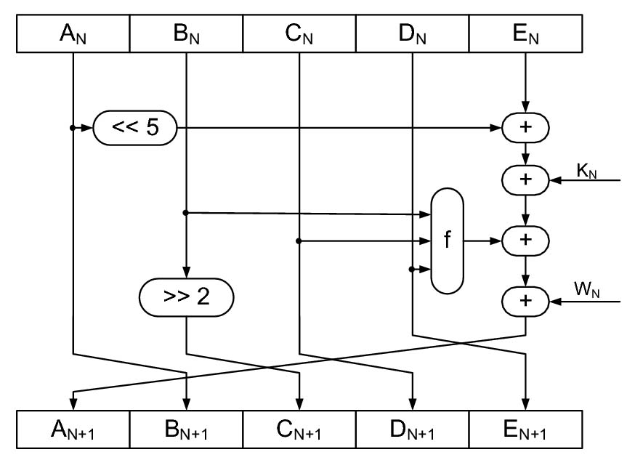
32bit reg.
Round const.
Input msg.
How SHA1 Algorithm Works (one iteration)
output length = 160 bits, f = non linear function

Slide 16
Examples of SHA-1 (fromhttp://en.wikipedia.org/wiki/SHA-1 )
SHA1("The quick brown fox jumps over the lazy dog") =
2fd4e1c6 7a2d28fc ed849ee1 bb76e739 1b93eb12
SHA1("The quick brown fox jumps over the lazy cog") =
de9f2c7f d25e1b3a fad3e85a 0bd17d9b 100db4b3
we can see that even a small change in the message will, with overwhelming probability, result in a completely different hash due to the avalanche effect
The hash of the zero-length string is:
SHA1("") =
da39a3ee5e6b4b0d3255bfef95601890afd80709

